Slide 1
CS3081: “Artificial Intelligence”
Probabilistic Reasoning
Prof Passent Elkafrawy
pelkafrawy@effatuniversity.edu.sa
CoE112, ext 7896

Slide 2
Reading R&N
Chapter 12,
Chapter 14.1-2.
The slides were inspired from:
Stuart Russell and Dawn Song - University of California, Berkeley
Doina Precup

Slide 3
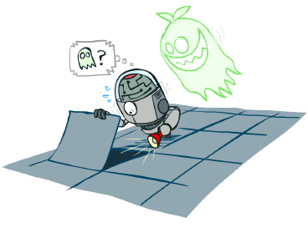
Outline
We are done with
Part 1: Search
Part 2: Logical Agents
Part 3: Probabilistic Reasoning
Diagnosis
Speech recognition
Tracking objects
…

Slide 4
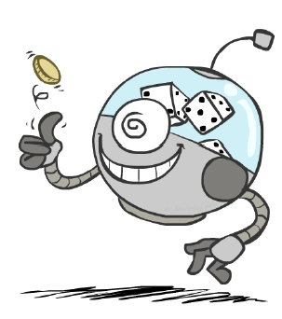
Outline
Probability
Random Variables
Joint and Marginal Distributions
Conditional Distribution
Product Rule, Chain Rule, Bayes ’ Rule
Inference
Independence

Slide 5
Outline of the course
unknown
RL
known
deterministic
stochastic
atomic
SEARCH
MDPs
factored
LOGIC
Bayes nets
structured
First-order logic

Slide 6
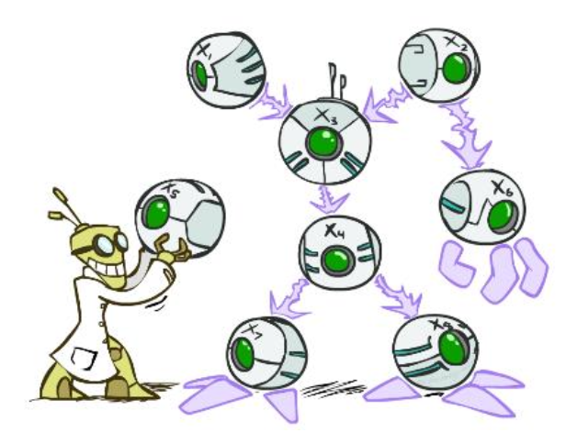
Bayes’ Nets
Bayes’ nets: a technique for describing complex joint distributions (models) using simple, local distributions (conditional probabilities)
▪ More properly called graphical models.
▪ We describe how variables locally interact.
▪ Local interactions chain together to give global, indirect interactions.

Slide 7
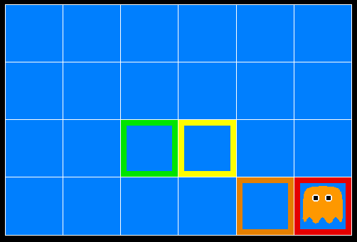
Inference in Ghostbusters
A ghost is in the grid somewhere
Sensor readings tell how close a square is to the ghost
On the ghost: red
1 or 2 away: orange
3 or 4 away: yellow
5+ away: green
Sensors are noisy, but we know P(Color(x,y) | DistanceFromGhost(x,y))
P(red | 3) | P(orange | 3) | P(yellow | 3) | P(green | 3)
0.05 | 0.15 | 0.5 | 0.3

Slide 8

Video of Demo Ghostbusters – No probability

Slide 9
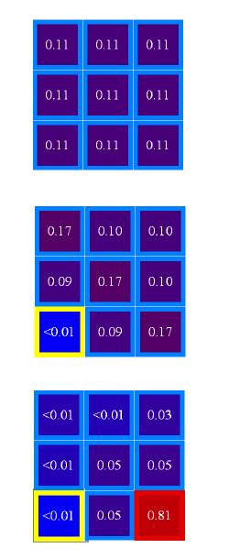
Uncertainty
General situation:
Observed variables (evidence) evidence): Agent knows certain things about the state of the world (e.g., sensor readings or symptoms).
Unobserved variables : Agent needs to reason about other aspects (e.g. where an object is or what disease is present).
Model : Agent knows something about how the known variables relate to the unknown variables.

Slide 10
Uncertain knowledge
Intelligent systems have to deal with uncertainty!
Predicting the behavior of other people
Partial knowledge of the state of the world e.g., We don’t know exactly what is going on in their mind
Noisy observations e.g., Smiling or frowning, making faces
Inherent stochasticity e.g. ,Today she likes the DVD, tomorrow she does not!
Phenomena that are not covered by our models e.g., Level of hormones, which depend on food, exercise, ...

Slide 11
How do we deal with uncertainty?
AI focus on building models that capture the uncertainty about the state of the world, the dynamics of the system and about our observations.
The model will then be used to reason about the world, and about the effects of different actions.
Important questions:
What mathematical formalism should we use? What is the meaning of our model?
What queries can the model answer? What is the method for answering queries?
How do we construct a model? Do we need to ask an expert, or can the model be learned from data?

Slide 12
AI approaches towards uncertainty
Default reasoning: believe something until evidence to the contrary is found
Rules with “fudge factors”
Fuzzy logic: allows events to be “sort of true”
Probability
Probabilistic reasoning gives us a framework for managing our beliefs and knowledge.

Slide 13
Probability
A well-known and well-understood framework for dealing with uncertainty
Has a clear semantics
Provides principled answers for:
Combining evidence
Predictive and diagnostic reasoning
Incorporation of new evidence
Can be learned from data
Arguably intuitive to human experts
Key idea: exploit regularities and structure of the domain
We will focus mainly on exploiting conditional independence
properties

Slide 14
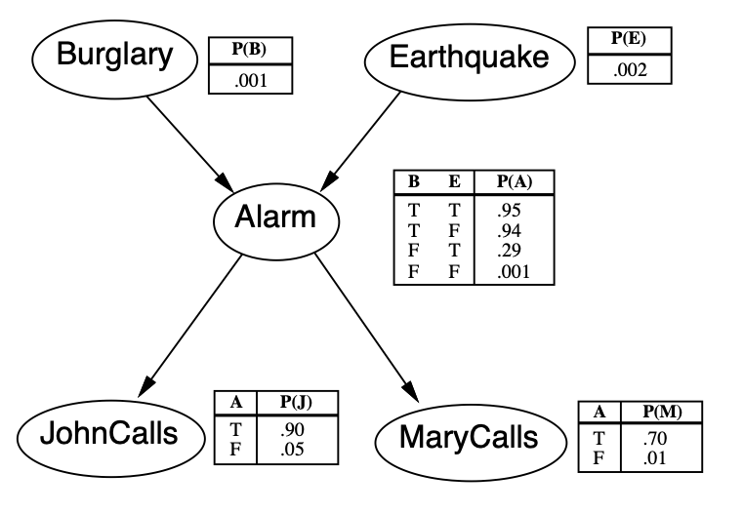
Example: A Bayesian (belief) network

Slide 15
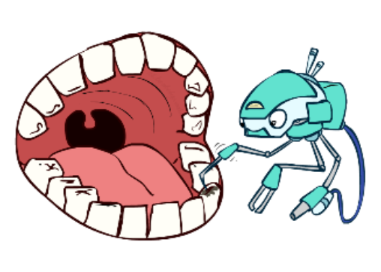
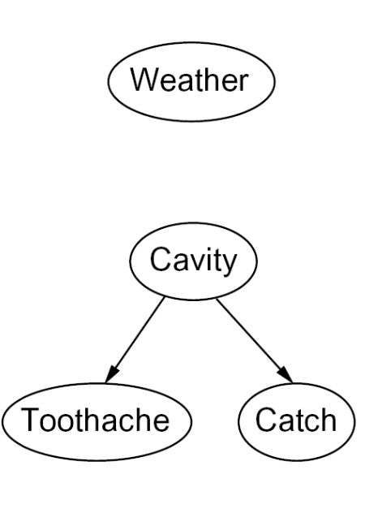
Graphical model notation
Nodes: variables (with domains)
Can be assigned (observed) or unassigned (unobserved)
Arcs: interactions
Similar to CSP constraints
Indicate “direct influence” between variables
Formally: encode conditional independence (more later)
For now: imagine that arrows mean direct causation (in general, they don’t!)

Slide 16
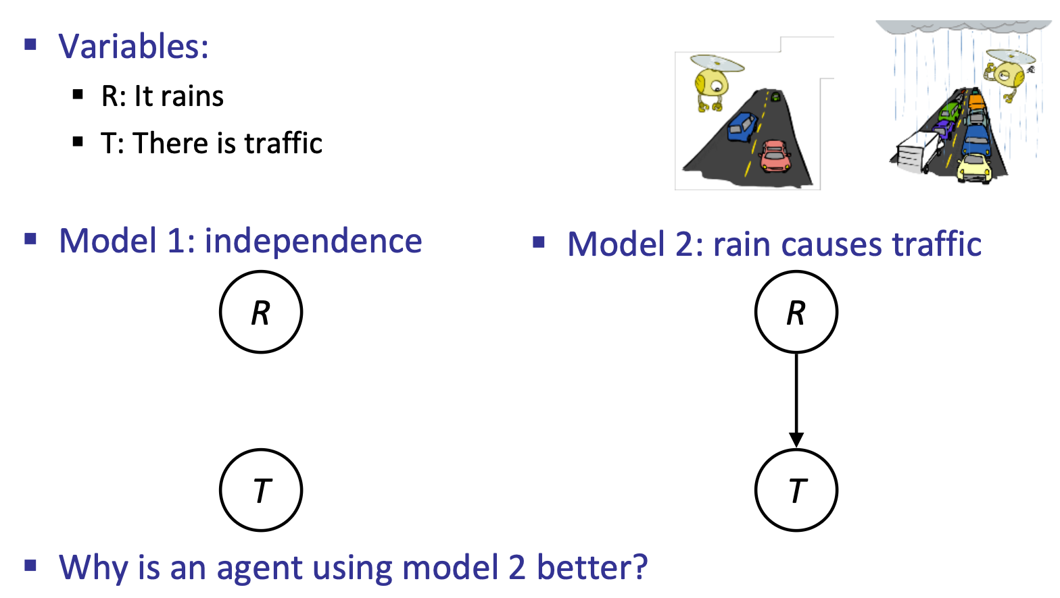
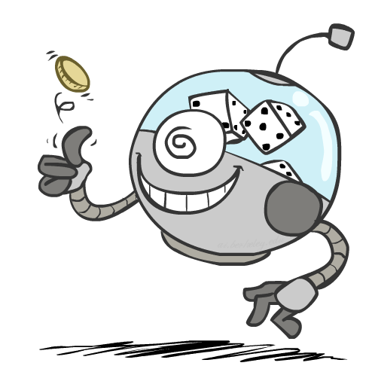
Independent vs. dependence Models

Slide 17
Decision making
Suppose you believe the following:
P (girlfriend likes Terminator DVD| . . .)
P (girlfriend likes cashmere sweater| . . .)
P (girlfriend likes diamond necklace| . . .)
Which action should you choose?
= 0.04
= 0.70
= 0.9999

Slide 18
Decision making
Suppose you believe the following:
P (girlfriend likes Terminator DVD| . . .)
P (girlfriend likes cashmere sweater| . . .)
P (girlfriend likes diamond necklace| . . .)
Which action should you choose?
Depends on preferences for making her happy vs. your own interest vs. cost
Probability is not enough for choosing actions
We also need to consider risks and payoffs Utility theory is used to represent and infer preferences
Decision theory = utility theory + probability theory
= 0.04
= 0.70
= 0.9999

Slide 19
Practical decision making
We need to represent both probabilities and utilities
The expected utility of actions is computed given evidence and
past actions
A “rational” agent should choose the action that maximizes
expected utility
Value of information: is it worth acquiring more information in
order to choose better actions?

Slide 20
What is a random variable?
Something that has not happened yet: – Will a tossed coin come up heads or tails?
– Will the cancer recur or not?
Something you do not know . . .
Did the coin come up heads or tails?
How did the protein fold?
. . . because you have not/cannot observe it directly or compute it definitively from what you have observed.

Slide 21
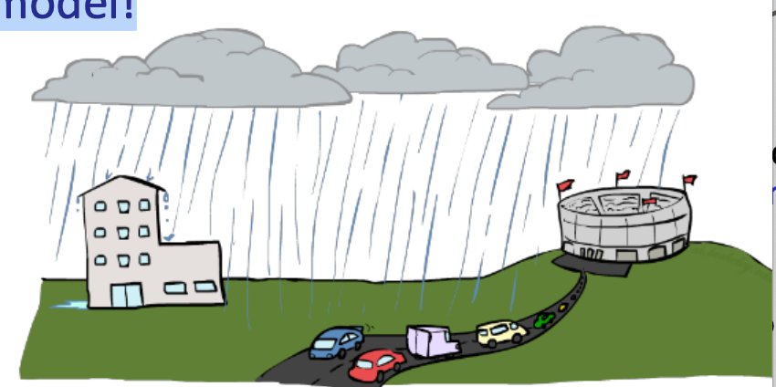
Let’s build a causal graphical model!
A random variable (usually denoted by a capital letter) is some aspect of the world about which we (may) be uncertain
R = Is it raining?
T = Is it hot or cold?
D = How long will it take to drive to work?
L = Where is the ghost?
Like variables in a CSP, random variables have domains
R in {true, false} (often write as {+r, r})
T in {hot, cold}
D in [0, infinity)
L in possible locations, maybe {( 0,0 ), (0,1)…}

Slide 22
Discrete random variables
A discrete random variable X takes values from a discrete set Ω_{X}, called the domain or sample space of X.
X = roll of a die; Ω_{X} = {1,2,3,4,5,6}.
X = nucleotide a position 1, chromosome 1, in a particular person; Ω_{X} ={A,C,G,T}.
X = does a customer buy a new TV or not
An event is a subset of Ω_{X} . • e₁ = {1} corresponds to a die roll of 1 • e₂ = {1, 3, 5} corresponds to an odd value for the roll

Slide 23
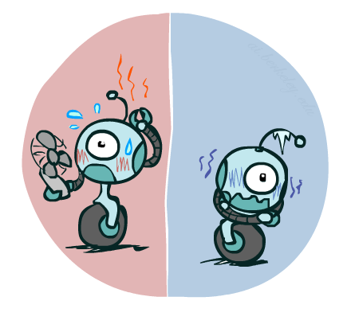
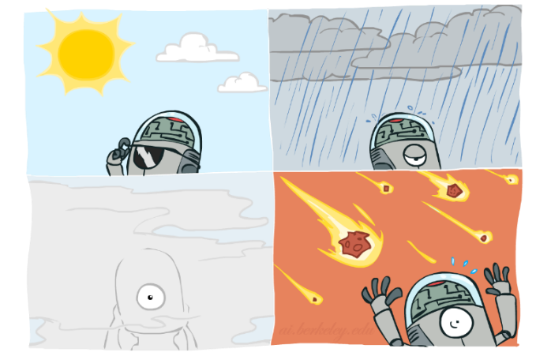
Probability Distributions
Associate a probability with each value; sums to 1
Temperature:
Weather:
P(T)
P(W)
W | P
sun | 0.6
rain | 0.1
fog | 0.3
meteor | 0.0
T | P
hot | 0.5
cold | 0.5

Slide 24
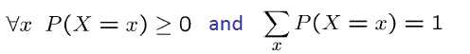
Probability Distributions
Radom variables have distributions
Temperature:
A distribution is a TABLE of probabilities of values
A probability (lower case value) is a single number P(W = rain) = 0.1
Must have:
Weather:
Shorthand notation:
P(hot) = P (T = hot),
P(cold) = P (T = cold),
P(rain = P (W = rain),
…
Ok if all domain entries are unique
P(W)
P(T)
W | P
sun | 0.6
rain | 0.1
fog | 0.3
meteor | 0.0
T | P
hot | 0.5
cold | 0.5

Slide 25
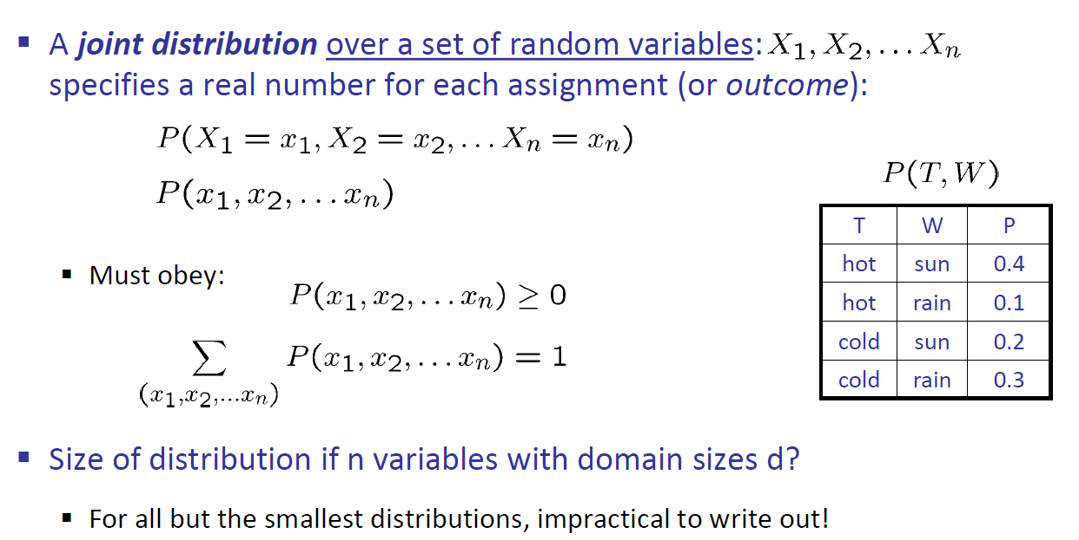
Joint Distributions
d is the possible number of value for each X_{i} then the size of the distribution is d^{n}

Slide 26
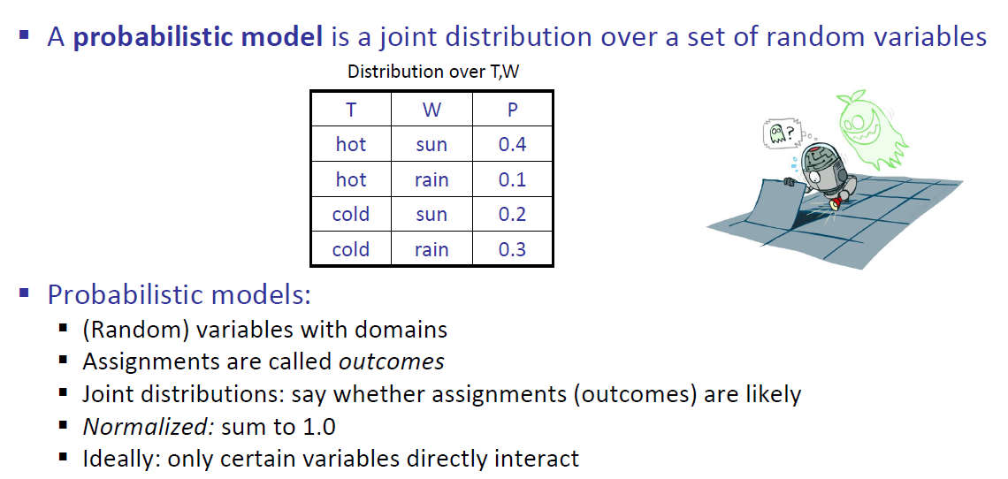
Probabilistic Models

Slide 27
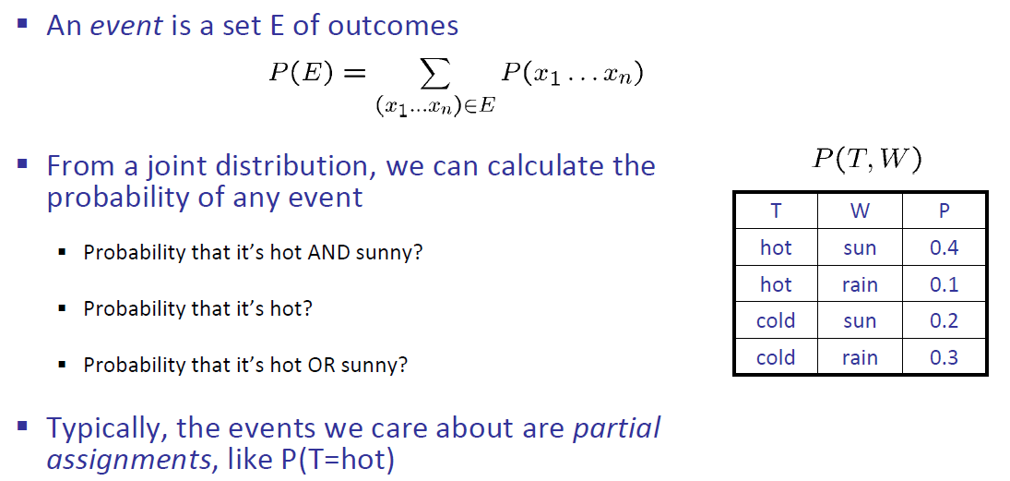
Events

Slide 28
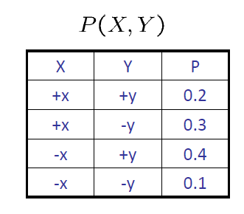
Quiz: Events
P(+x, +y) ?
P(+x) ?
P(-y OR +x) ?
0.2
0.5
0.6

Slide 29
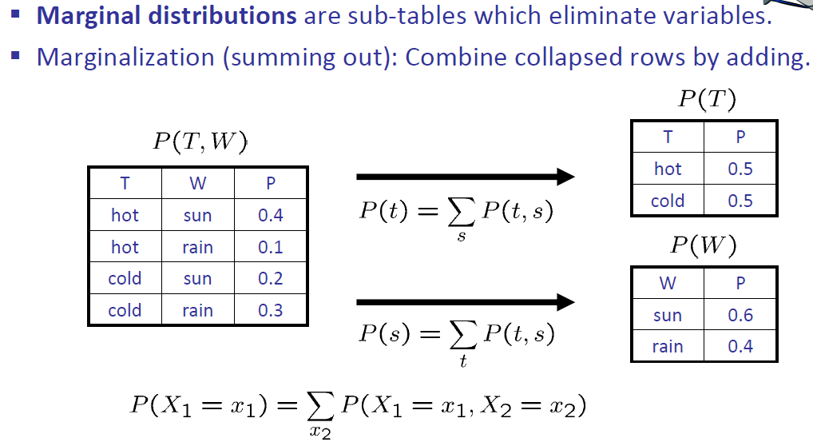
Marginal Distribution

Slide 30
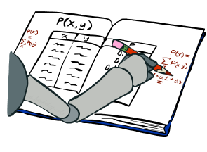
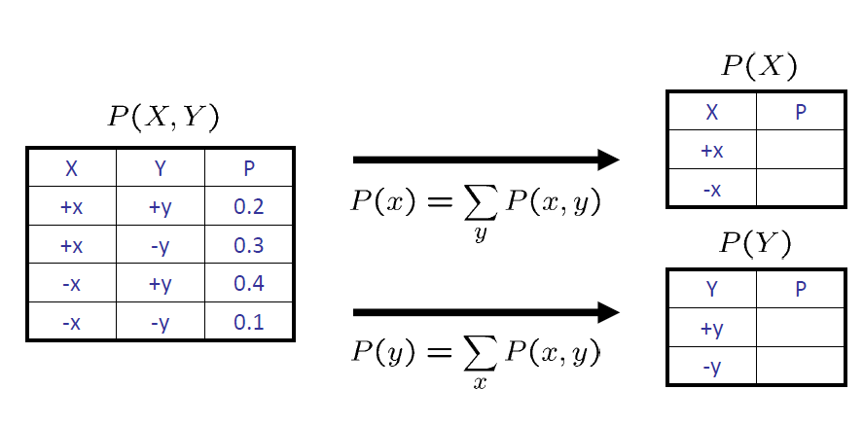
Quiz: Marginal Distribution

Slide 31
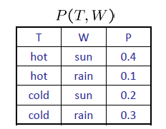
Conditional Probabilities
A simple relation between joint and conditional probabilities taken as the definition of a conditional probability
P(a,b)
P(a, b)
P(b)
P(a | b) =
P(a)
P(b)
P(W=s,T=c)
P(T=c)
P(W=s | T=c) =
= 0.2/0.50 = 0.4
= P(W=s,T=c) + P(W=r,T=c) = 0.2 + 0.3 = 0.50

Slide 32
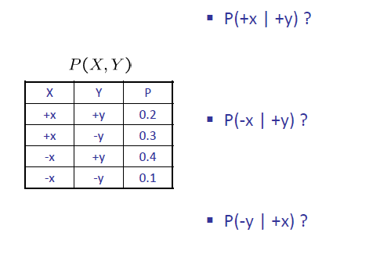
Quiz: Conditional Probabilities
P(a, b)
P(b)
P(a | b) =
P(+x, +y)
P(+y)
P(+x | +y) =
P(-x, +y)
P(+y)
P(-x | +y) =
P(-y, +x)
P(+x)
P(-y | +x) =

Slide 33
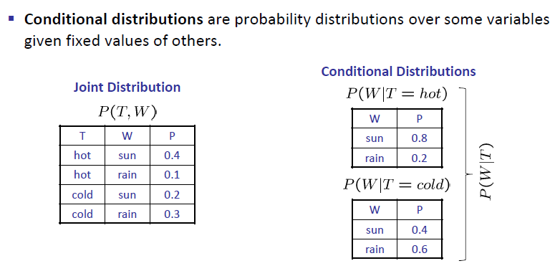
Conditional Distributions

Slide 34
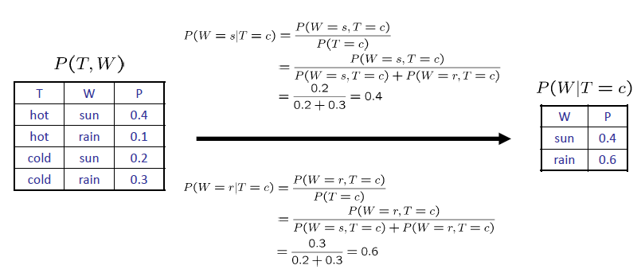
Normalization Trick

Slide 35
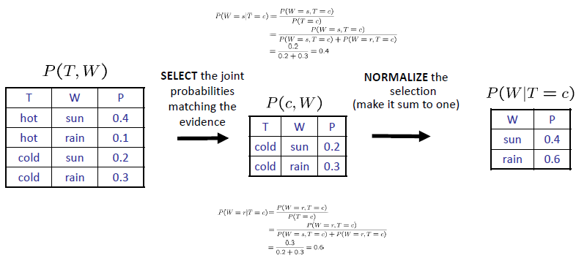
Normalization Trick

Slide 36
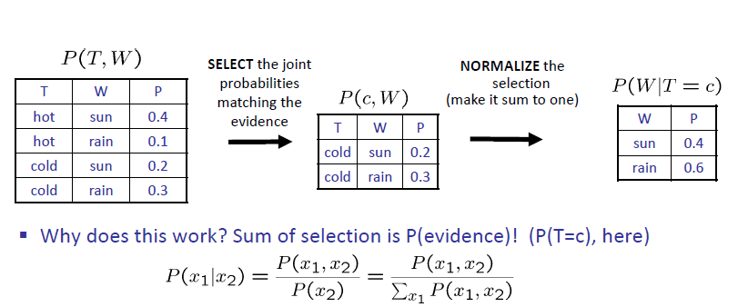
Normalization Trick

Slide 37
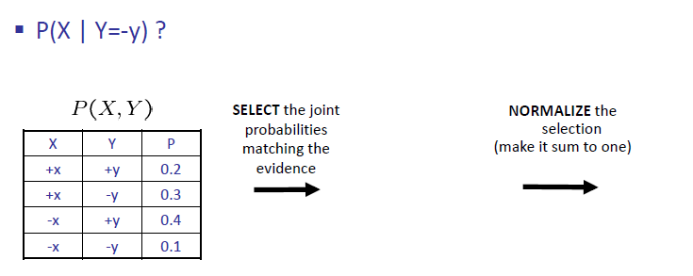
Quiz: Normalization Trick

Slide 38
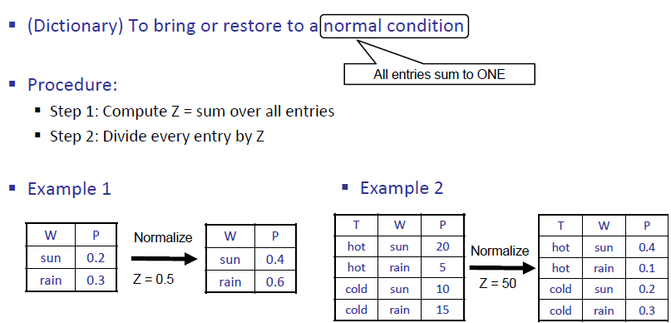
To Normalize

